Slide 1


PERSONAL DIARY MANAGEMENT SYSTEM
CSE115.4 · GROUP 7
Project update · C Semester Project
COURSE CODE: CSE115.4
Jannati · Zara · Juthi · Sanjida · Elma
Notes:
Introduce the project and the team. This is a project update, so we only show what each module has done so far.

Slide 2
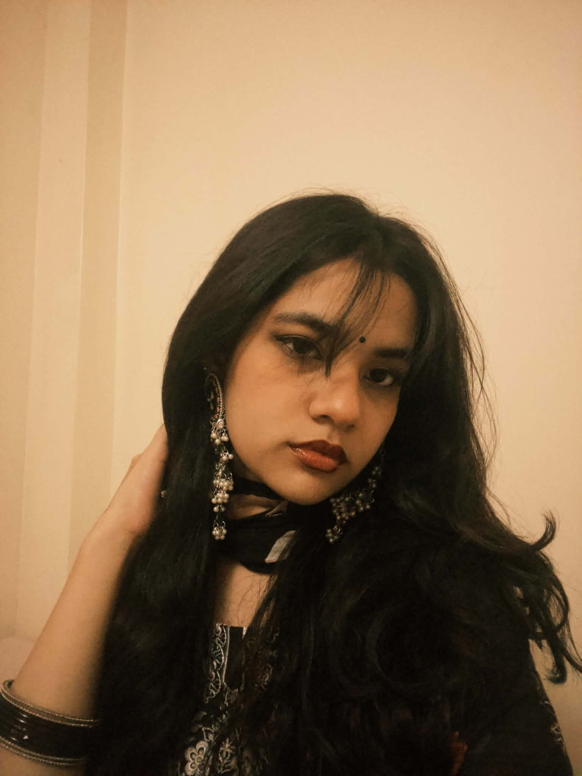
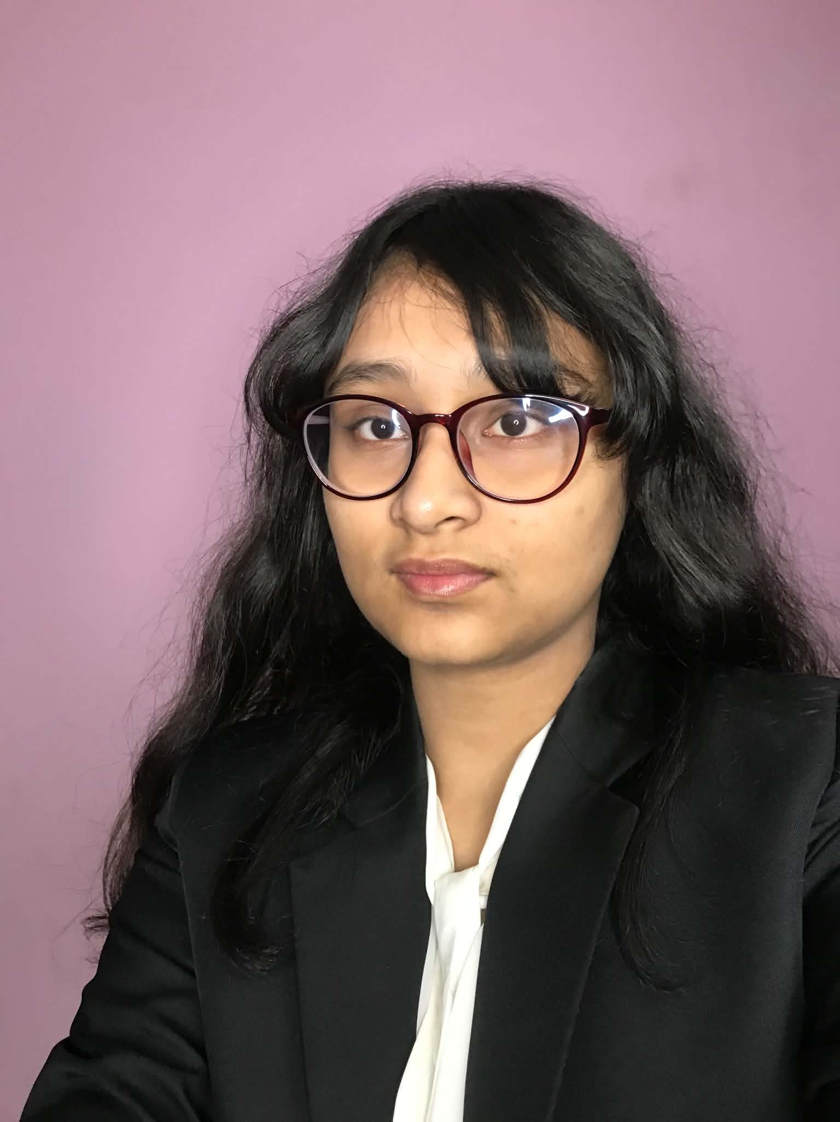
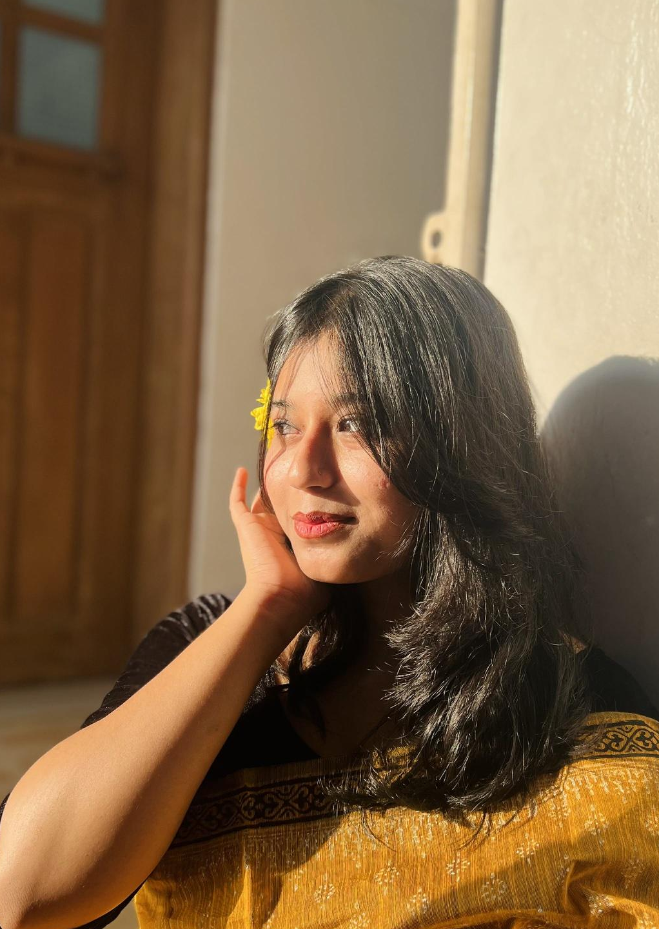
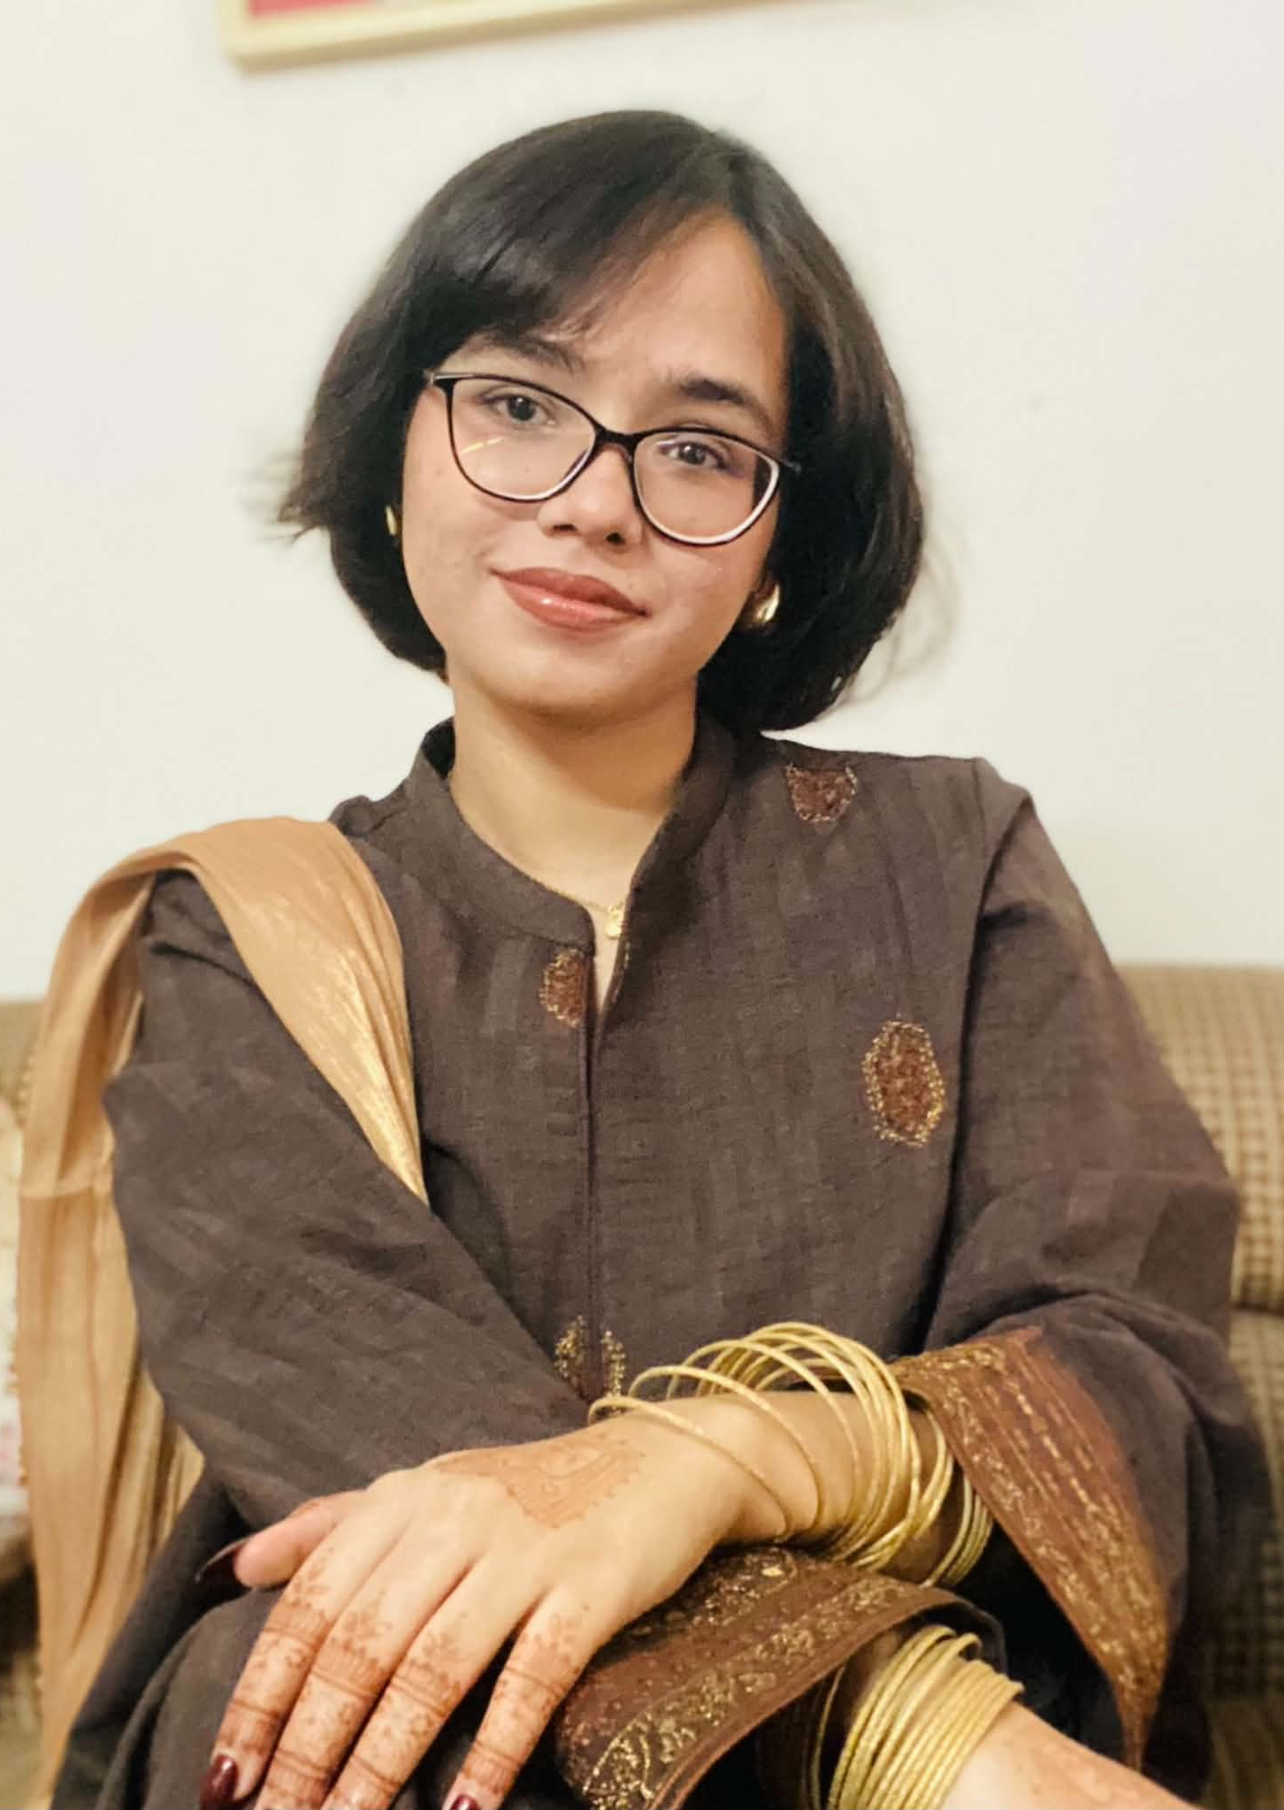
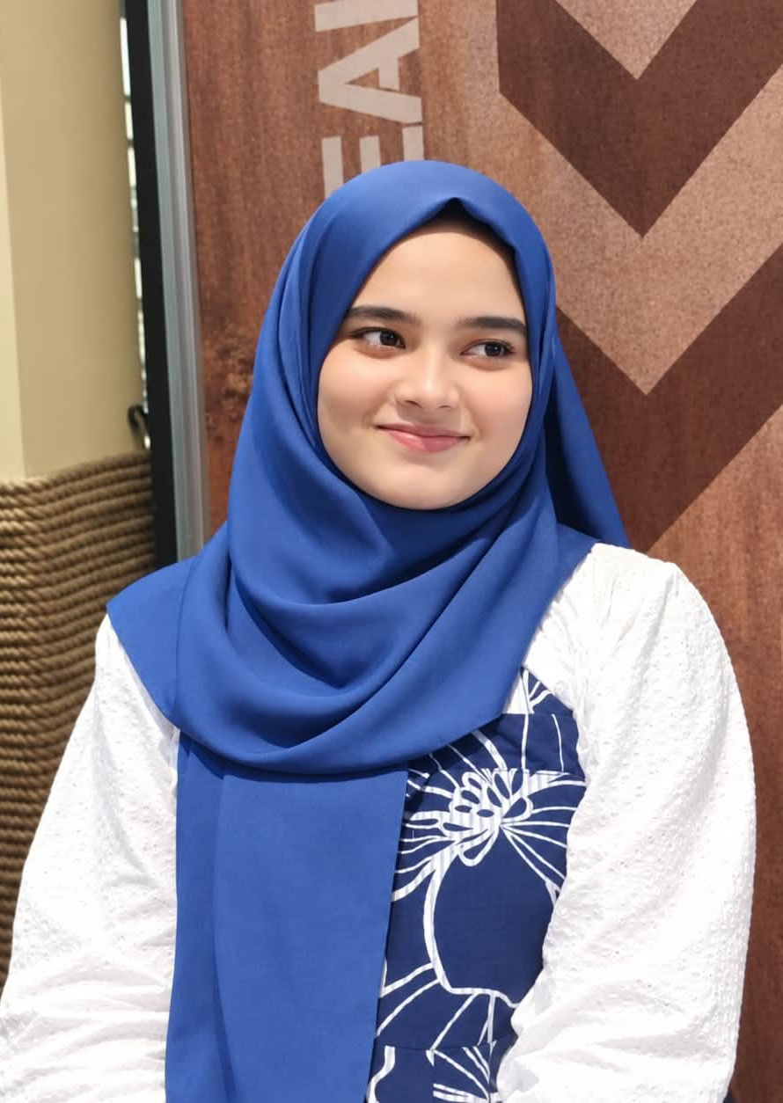
OUR TEAM
CSE115.4 · GROUP 7
JANNATI ANISHA BONNA
ZARA MAMNOON
JINNAT JAHAN JUTHI
SANJIDA RAHMAN BARSHA
ELMA SHAHRIN KHAN
Login & credentials
Add Entry, View
Helper Functions
ID: 2633348642
ID: 2633619042
Search, Edit, Delete
Main()
ID: 2633012642
ID: 2631266042
ID: 2631487042
Notes:
Introduce each member and their module. Add each member's photo and student ID.

Slide 3



WHAT IS IT?
CSE115.4 · GROUP 7
A C program that keeps a private personal diary on the computer.
Manage entries
Add, view, edit, delete and search from one menu.
Store in files
File handling keeps entries after the program closes.
Protect privacy
Login and encryption keep the diary private.
Jannati · Zara · Juthi · Sanjida · Elma
Notes:
A program to manage a personal diary: add, edit, delete and search entries, with file handling for storage and encryption for privacy.

Slide 4
WHY WE CHOSE IT
CSE115.4 · GROUP 7
Privacy matters
A diary holds personal thoughts, a real reason for login and encryption.
Practical C skills
Uses structs, strings, functions and file handling from our course.
Clear feature set
Add, view, edit, delete and search are easy to split and test.
Fits a team of five
Each member owns one module, and the modules join in Main.
Jannati · Zara · Juthi · Sanjida · Elma
Notes:
Edit these reasons to match what your group actually discussed.

Slide 5
OBJECTIVES
CSE115.4 · GROUP 7
01
02
Add and view diary entries
Edit, delete and search entries
03
04
Store data using file handling
Protect privacy with login and encryption
Jannati · Zara · Juthi · Sanjida · Elma
Notes:
Four goals taken from the project brief.

Slide 6
SYSTEM ARCHITECTURE
CSE115.4 · GROUP 7
Main
ENTRY POINT
Menu and program flow
Login
Add and View
Search, Edit, Delete
FEATURES
Access to the diary
Create and read entries
Find and change entries
Helper Functions
FOUNDATION
Shared utility functions used by every module
Jannati · Zara ·Juthi · Sanjida · Elma
Notes:
Five modules in three layers. Main calls the feature modules, and all of them use the helper functions.

Slide 7
TASK DIVISION
CSE115.4 · GROUP 7
Module | Member | Responsibility
1. Helper Functions | Jannati Anisha Bonna | Shared utility functions
2. Login | Zara Mamnoon | Login and access control
3. Diary Features: Add Entry, View | Jinnat Jahan Juthi | Add and view entries
4. Diary Features: Search, Edit, Delete | Sanjida Rahman Barsha | Find, change and remove entries
5. Main() | Elma Shahrin Khan | Menu linking all modules
Jannati · Zara · Juthi · Sanjida · Elma
Notes:
Five members, five modules.

Slide 8
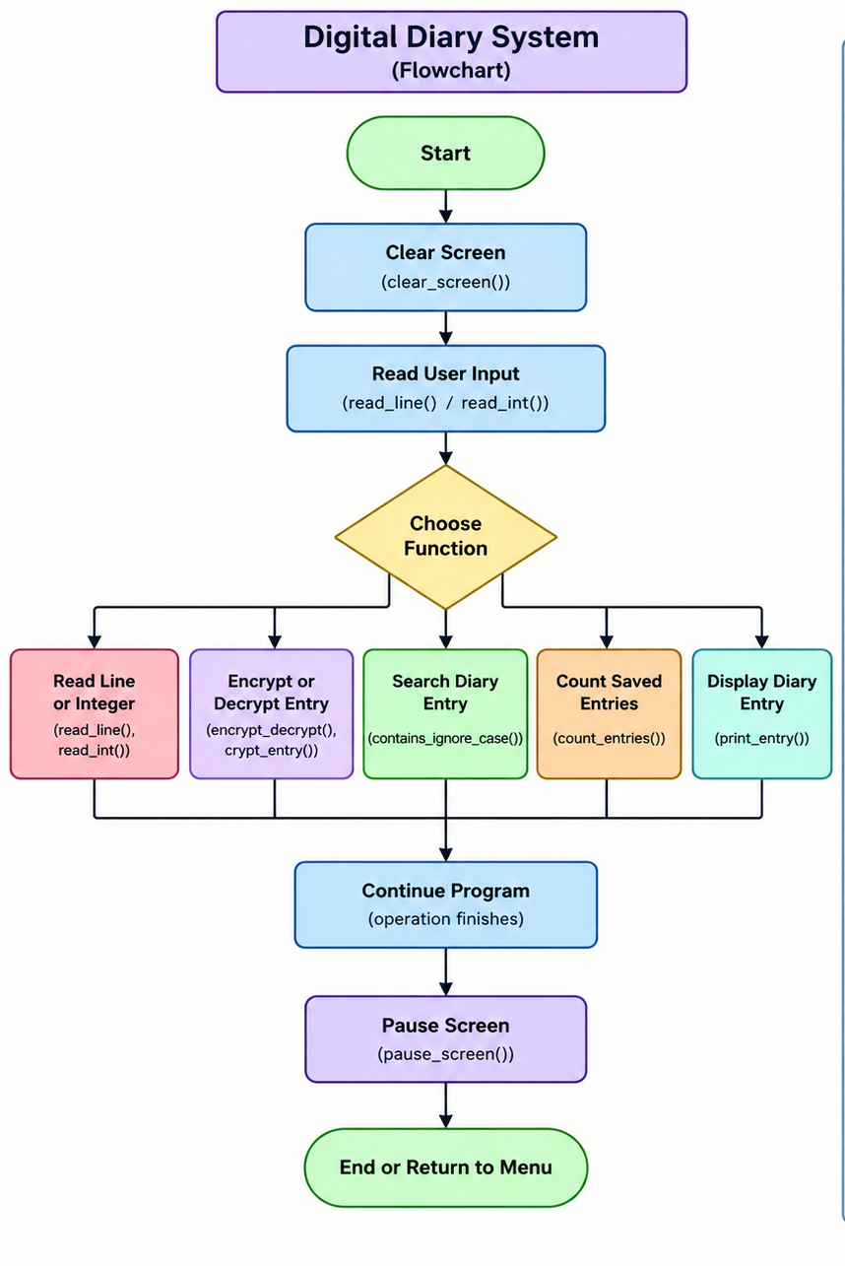
HELPER FUNCTIONS
CSE115.4 · GROUP 7
MODULE 1 · JANNATI
Allows other functions do a specific task.
Clears the console screen.
Reads input and removes newline characters.
Pauses the screen until Enter is pressed.
Encrypts and decrypts.
Searches text (ignores uppercase and lowercase)
Counts saved diary entries in the file.
Displays diary entries with date, title, and content.
Jannati · Zara · Juthi · Sanjida · Elma
Notes:
Jannati explains the helper functions and which modules use them. Edit the bullets to the real functions.

Slide 9
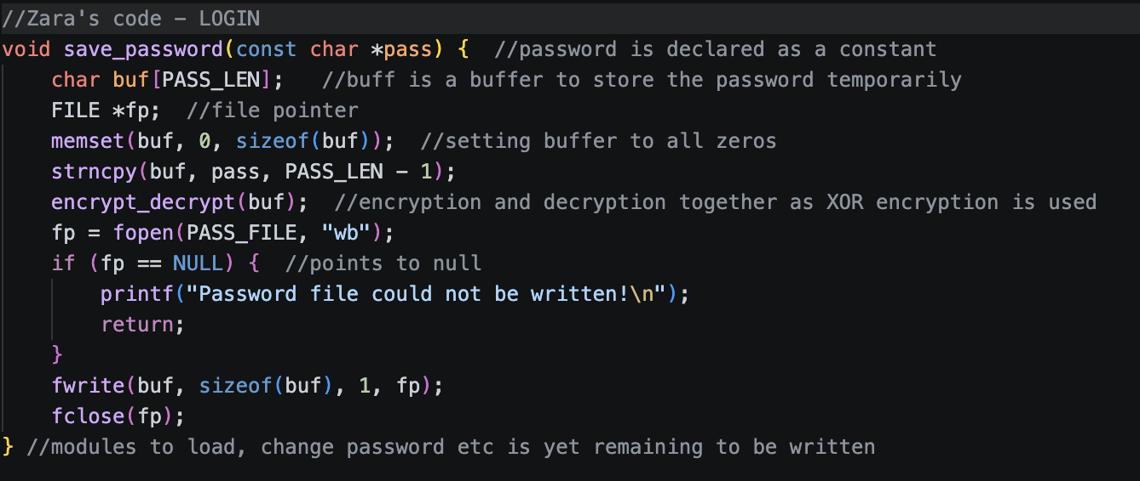

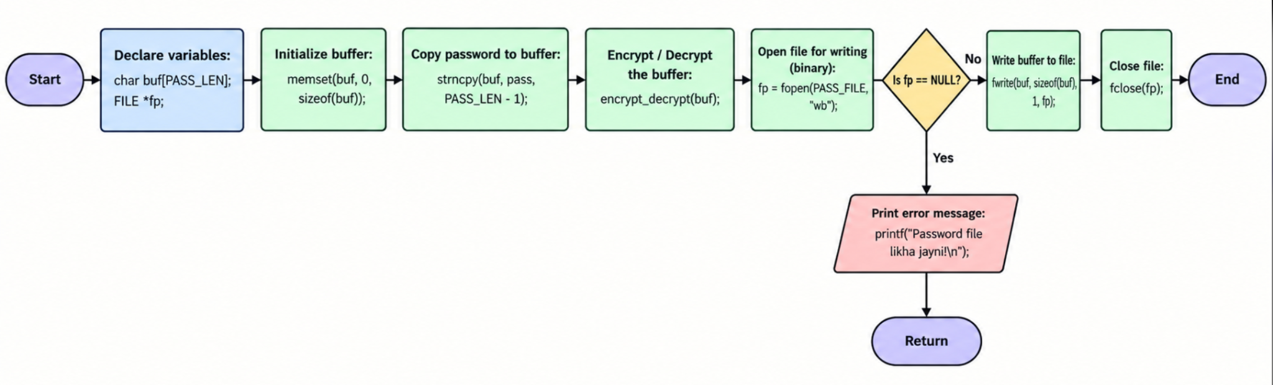

LOGIN
CSE115.4 · GROUP 7
MODULE 2 · ZARA MAMNOON
It manages access to the diary by checking whether the user knows the password
DONE
Designing the serial of functions & writing password into the file
PENDING
Load password, check if logged in, set new password, change password
Jannati · Zara · Juthi · Sanjida · Elma
Notes:
Zara explains how login protects the diary. Edit the bullets to match the real login steps.

Slide 10


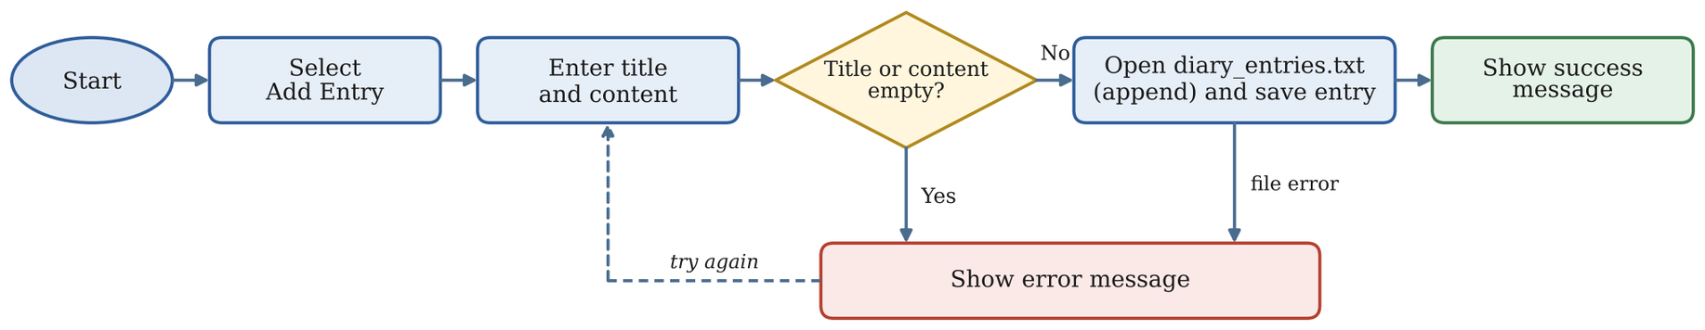
CSE115.4 · GROUP 7
MODULE 3 · JINNAT JAHAN JUTHI
ADD ENTRY AND VIEW
// code - Add Entry
printf ("Content: ");
Add Entry is done. View Entries is still pending.
read_line(e.content, sizeof(e.content));
/* ---------- Add ---------- */
void add_entry() {
struct Entry e;
crypt_entry(&e); /* encrypt before saving */
DONE
FILE *fp;
CODE
Add Entry
memset(&e,0 , sizeof(e)); /* so that no garbage data goes into the file */
fp = fopen(DIARY_FILE, "ab");
time_t t = time(NULL);
if (fp == NULL) {
Lets the user write a new entry and save it.
struct tm *info = localtime(&t);
Takes title and content, adds the date
strftime(e.date, sizeof(e.date), %d-%m-%Y", info);
printf("Could not open the file!\n");
Encrypts and saves the entry to the file
printf("Title: ");
Shows a success message
read_line(e.title, sizeof(e.title));
return;
}fwrite(&e,sizeof(struct Entry),1,fp);
fclose(fp);
printf(“Entry saved(%s)\n”,e.date); }
if (strlen(e.title) == 0) {
printf("Title cannot be empty.\n");
return;
}
PENDING
FLOW CHART
To be added
View Entries
Shows all saved entries on the screen.
Read the entries from the file
Add the flow chart here
Decrypt and show date, title and content
Handle an empty diary clearly
Jannati · Zara · Juthi · Sanjida · Elma
Notes:
Jinnat Jahan Juthi has finished the Add Entry part. The View part is still pending.

Slide 11
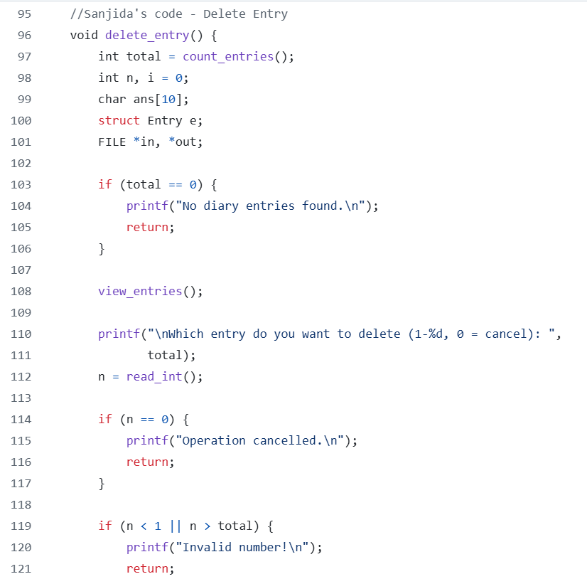
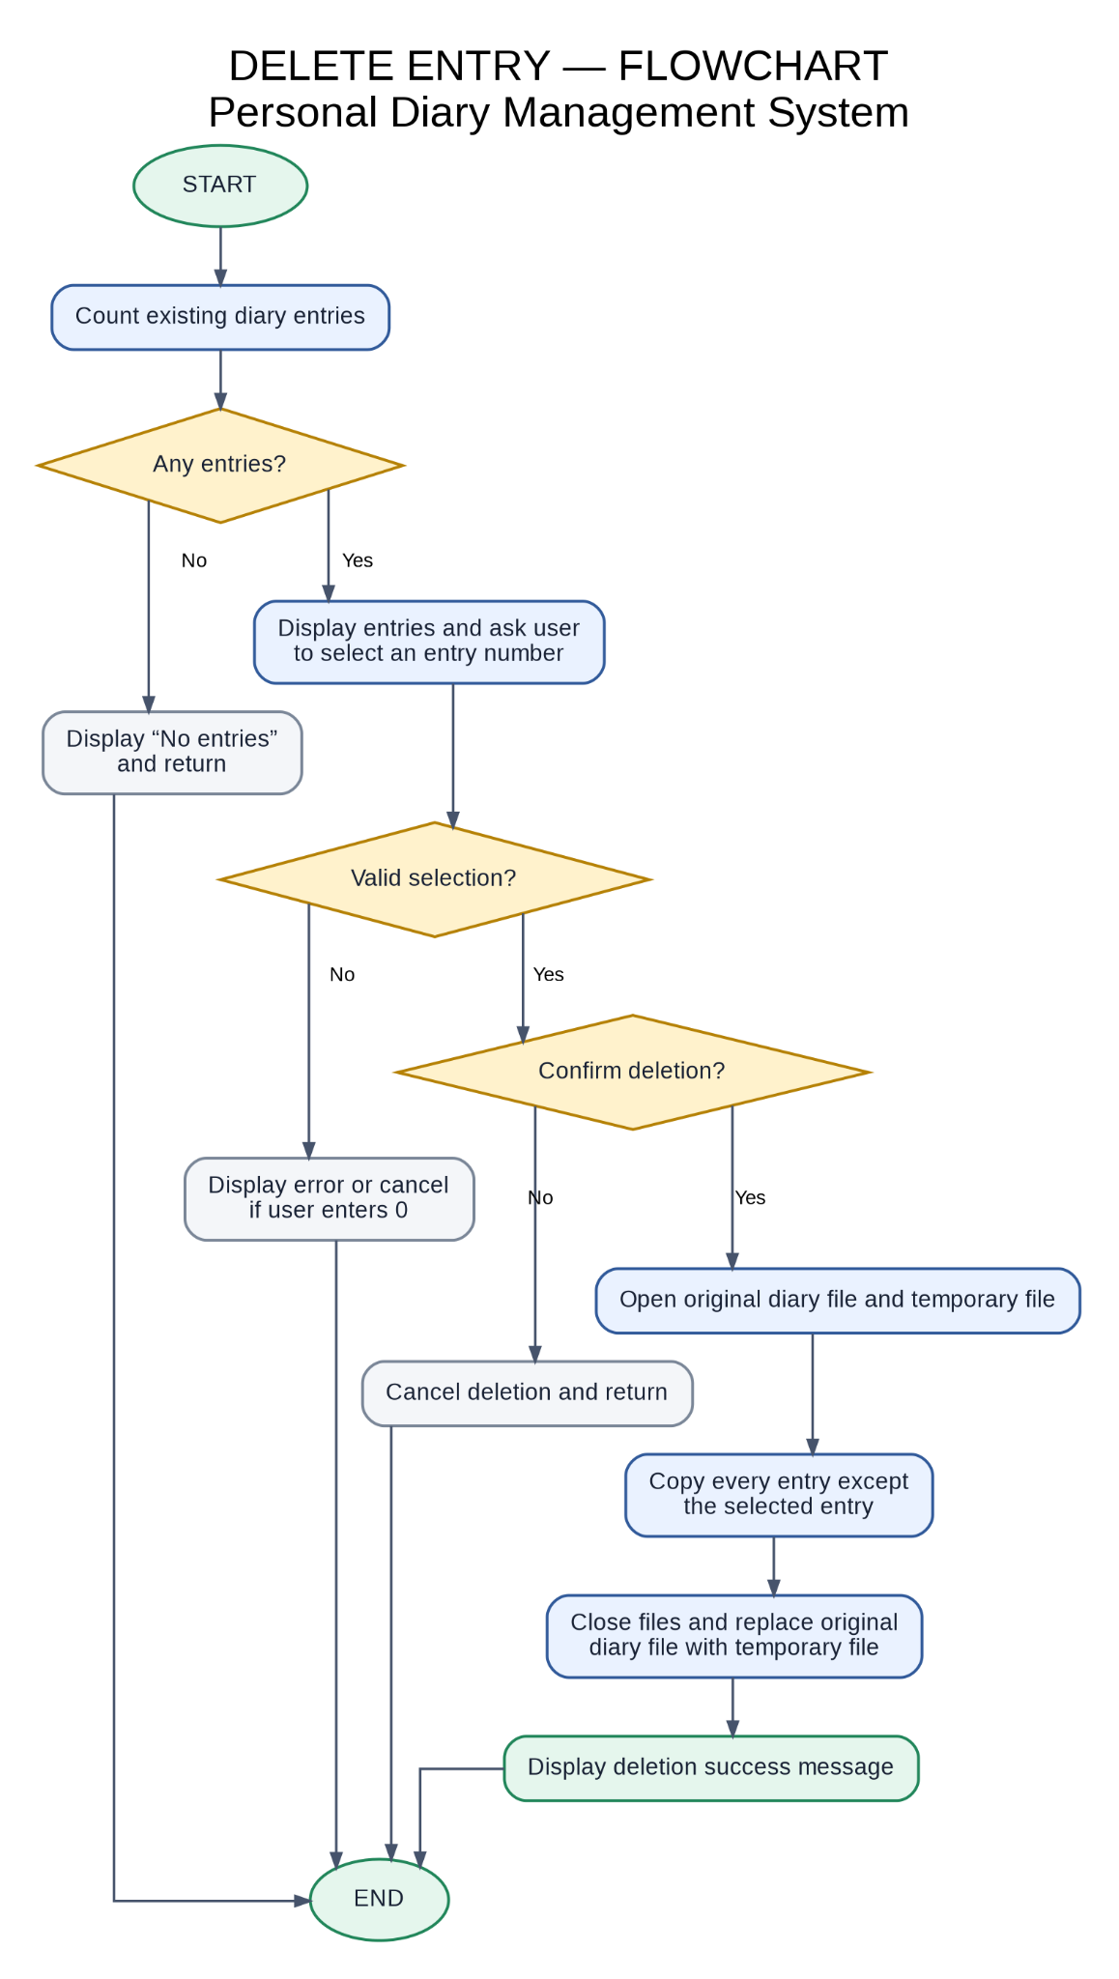
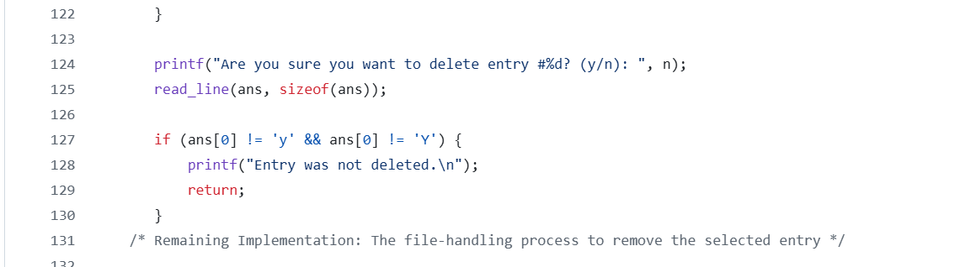
SEARCH, EDIT AND DELETE
CSE115.4 · GROUP 7
MODULE 4 · SANJIDA
Search Entry: Finds diary entries using keywords.
Edit Entry: Modifies and saves an existing entry.
Delete Entry: Removes a selected diary entry.
DONE
Delete Entry: Checks existing entries, asks confirmation before proceeding.
PENDING
Search Entry · Edit Entry
Jannati · Zara · Juthi · Sanjida · Elma
Notes:
Barsha shows search, edit and delete. Edit the bullets to match the real code.

Slide 12
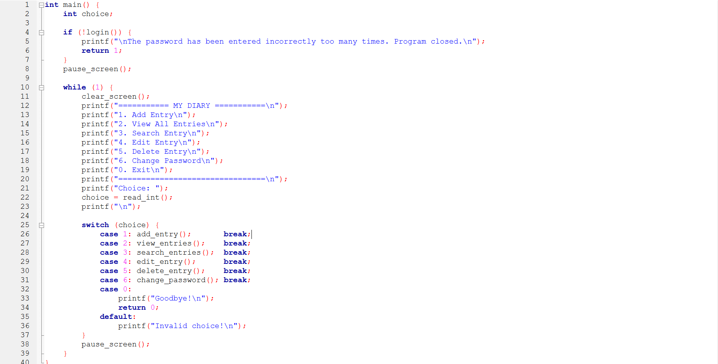
MAIN()
CSE115.4 · GROUP 7
MODULE 5 · ELMA
The menu that ties every module together.
Starts with login, then opens the diary
Shows the main menu
Calls the right module for each choice
Jannati · Zara · Juthi · Sanjida · Elma
Notes:
Elma shows the main menu and how it connects all modules. Edit the bullets to match the real code.

Slide 13



CURRENT PROGRESS
CSE115.4 · GROUP 7
4 of 8 steps done · 1 in progress · 3 to be done
DONE
DONE
DONE
DONE
Identify structures, variables and constants
Identify the header files to be used
Map out the design of the program
Divide the operations into functions
IN PROGRESS
PROGRESS
TO BE DONE
TO BE DONE
Write the code for the functions
Call the functions in main()
Debugging and testing
Finish the final product
Jannati · Zara · Juthi · Sanjida · Elma
Notes:
We have finished the design work: structures, header files, program design and splitting the operations into functions. Now we are writing the code for the functions. Calling them in main, debugging and testing, and the final product are still to be done. All code is shared on GitHub.

Slide 14
CSE115.4 · GROUP 7
IN PROGRESS...
Iiiiii
DEMO SCREENSHOT
Jannati · Zara · Juthi · Sanjida · Elma
Notes:
Show the working part of the program. At the moment this is the Add Entry feature. Paste a screenshot into the frame.

Slide 15

HOW AN ENTRY IS STORED
CSE115.4 · GROUP 7
SAVING AN ENTRY
Step 1
Step 2
Step 3
User types the entry
Text is encrypted
Saved to the diary file
VIEWING AN ENTRY
Step 1
Step 2
Step 3
Read from the diary file
Text is decrypted
Shown on screen
Jannati · Zara · Juthi · Sanjida · Elma
Notes:
This shows the intended flow: entries are encrypted before they reach the file and decrypted only when shown. Check it matches how your code works.

Slide 16




CHALLENGES
CSE115.4 · GROUP 7
Learning GitHub
Keeping the design simple
Sharing and combining code from five members.
Finding the simplest and most efficient program.
Joining five modules
Team communication
Shared functions and file format must match.
Keeping all members updated on every change.
Jannati · Zara · Juthi · Sanjida · Elma
Notes:
From our report: we are learning GitHub, designing the simplest and most efficient program, and keeping proper communication between all members.

Slide 17

NEXT STEPS
CSE115.4 · GROUP 7
Finish writing the code for the functions
Call the functions in main()
Debugging and testing
Finish the final product
Jannati · Zara · Juthi · Barsha · Elma
Notes:
These are the remaining steps from our report. Pending parts such as View Entries are part of the code still being written.

Slide 18
THANK YOU
CSE115.4 · GROUP 7
Jannati · Zara ·Juthi · Sanjida · Elma
Notes:
Close and take questions.

